Slide 1

From Data to Decision: A Data-Driven Roadmap for COMPANY X
Present by: Gwedyonn Ashkevron, Jason Antunes, Linya Wang, Thanapol Shongtuptim, and Wilmer Garcia Tobar
Date: April 8th, 2026

Slide 2

Problem Statement and Context
Without unified dashboard
Can’t answer performance questions
So, we built a tool

Slide 3
Agenda
Goals
Our Approach
Key Findings
KPIs in Action
Recommendations
Next Steps
Q&A Time!

Slide 4
Goals
Increase strategic visibility
Improve account managers' decision-making ability
Identify and mitigate financial risk
Enable administrators to make data-driven decisions
Identify high-value clients and track efficiency
Monitor outstanding payments and cash flow

Slide 5


Our Approach
Workshop with company to understand the business and what goals we can support
1
Create a central dataset from the several small datasets
2
Standardize formats and ensure information is setup for analytics
4
Create a data dictionary to aid future analytics work
5
Explore the data to uncover business insights
6
Clean up the dataset to ensure analytics accuracy
3

Slide 6
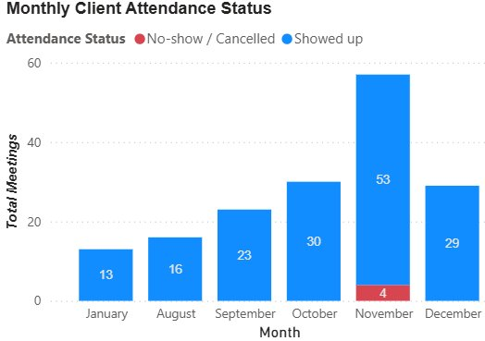
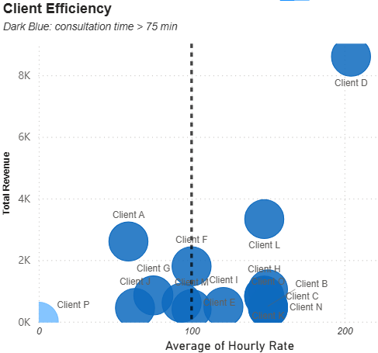
Key Finding 1 High Resource Consumption Does Not Equal High Profitability
Client A: Efficiency Gap
High meeting volume
Below-average hourly rate
High opportunity cost (No-shows)

Slide 7
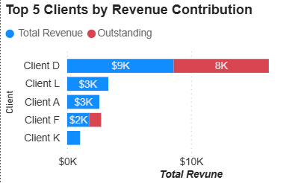
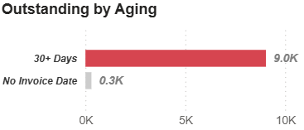
Key Finding 2 Half of Top Client Revenue is Overdue
Client D: The Cash Flow Risk
Top revenue generator: $9k
Critical payment delay: $8k
>50% of the contributions are debts
> 90% of debts overdue by > 30 days

Slide 8
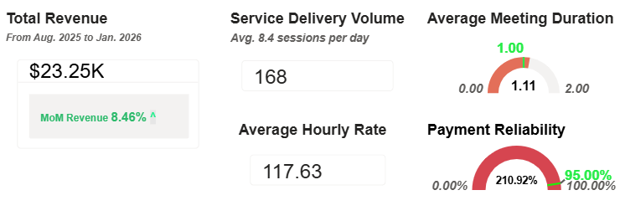
KPIs in Action
Good Growth: $23.25k revenue & 8.46% MoM growth
Average Rate: $117.63 per hour
Big Warning: 210.92% payment issues

Slide 9
Recommendation 1
Partial upfront deposit prior to consultations
The issue isn’t revenue generation – it’s collection
Define clear payment terms of 7, 15, or 30 days post-consultation
Fix the payment collection process:

Slide 10
Recommendation 2
Improve revenue efficiency per hour:
Reduce single client concentration for revenue
Adjust the pricing structure for new clients moving forward
Implement a minimum floor rate aligned with average hourly rate ($117.63) moving forward for new client engagements
Define client tiers to prioritize high-value scheduling

Slide 11
Recommendation 3
Target the high-rate/low-volume segment to diversify the portfolio
Ensure no single client exceeds 20% of total revenue
Actively develop new high-value client relationships:

Slide 12
Next Steps
Onboard account managers onto the new dashboard
Have a collections conversation with Client D
Draft payment terms and deposit policies and apply them to new clients going forward
Review findings on a quarterly basis
Standardize data entry practices

Slide 13
Q&A Time!
Thank You!

